Slide 1
Partners HealthCare System:
Improving Transitions of Care
The One Trick Pony Rides Again!
Partners Clinical Performance/ Department of Quality, Safety, & Value
Alison Holliday, MPH, Project Manager, Patient Safety PHS
Terrence O’Malley, MD, Medical Director, Non Acute Care Services PHS
MA Coalition for the Prevention of Medical Errors
May 20, 2013

Slide 2
Outline
The Pony’s One Trick
  Partners Continuing Care (PCC) to ED Transfers
    Problem
    Approach / Tools
    Results
How the Pony Learned the Trick
  Partners Hospital Discharges
    Problem
    Results
    Lessons Learned / Advice
Partners Clinical Performance | Quality, Safety & Value Dept

Slide 3
PCC to ED Transfers
The Problem
  Patients sent to the ED from PCC sites (Home Health, SNF, LTAC and IRF) arrive without the clinical information the ED clinicians need to provide safe, timely and appropriate care
  Examples:
    Patient received medication to which he was known to be allergic because allergies were not communicated
    ED clinicians unable to reach family members on home phone because they didn’t know to look for them in the ED waiting room
    Patient intubated in the ED for respiratory failure because her previously established DNR/DNI status was not communicated
  Result:
    Unsafe and inappropriate care
    Avoidable costs and readmissions
Partners Clinical Performance | Quality, Safety & Value Dept

Slide 4
The Trick: Approach and Tools
Identify what the ED clinicians want to receive
  Focus groups
  Prioritized by Network ED Chiefs
Scope down
  200 elements reduced to 44
  Start with 16
Measure
  Review all ED transfer packets for presence of essential data
Report
  “Complete” transfer packets: all 16 elements present
  Share performance with sending sites to trigger interventions
  Share best practices
  Feedback from the ED re: completeness, timeliness, and format
Partners Clinical Performance | Quality, Safety & Value Dept

Slide 5
Results: Five PCC Sites
Pre-Intervention (baseline) scores measured & reported
Overall | Total (Avg) | Site
 |  | A | B | C | D | E
Overall Completeness Score (% of “Complete” Transfer Packets) | 0.0% | 0.0% | 0.0% | 0.0% | 0.0% | 0.0%
Element
1. History of Current Issue | 86.4% | 83.9% | 98.0% | 95.0% | 97.3% | 57.7%
2. Current Active Clinical Conditions | 82.3% | 53.6% | 92.0% | 83.8% | 96.4% | 85.9%
3. Questions Sending Site Wants Answered | 56.6% | 8.0% | 82.0% | 45.0% | 90.2% | 57.7%
4. Clinician at Sending Site Available to Answer Questions | 77.7% | 54.5% | 92.0% | 51.3% | 94.6% | 96.2%
5. Clinician, if different, to Call with each Urgent Problem | 64.9% | 97.3% | 13.0% | 52.5% | 67.0% | 94.9%
6. Family Contact Information | 95.8% | 90.2% | 95.0% | 95.0% | 100.0% | 98.7%
7. Current Active Medications | 78.2% | 78.6% | 93.0% | 95.0% | 88.4% | 35.9%
8. Allergies | 93.3% | 76.8% | 100.0% | 96.3% | 94.6% | 98.7%
9. Mental Status at Transfer | 73.5% | 48.2% | 86.0% | 70.0% | 75.9% | 87.2%
10. Mental Status at Baseline, If Different | 42.5% | 17.0% | 34.0% | 25.0% | 49.1% | 87.2%
11. Ability to Consent to Treatment | 22.1% | 0.9% | 12.0% | 7.5% | 5.4% | 84.6%
12. Code Status | 84.4% | 79.5% | 100.0% | 75.0% | 71.4% | 96.2%
13. Orders for Life-Sustaining Treatment Form | 0.0% | 0.0% | 0.0% | 0.0% | 0.0% | 0.0%
14. Scheduled Treatments that may be required during ED stay | 47.9% | 9.8% | 83.0% | 31.3% | 64.3% | 51.3%
15. Patient May Return to Facility If… | 16.9% | 2.7% | 56.0% | 16.3% | 4.5% | 5.1%
16. Facility Capabilities | 10.9% | 0.9% | 35.0% | 18.8% | 0.0% | 0.0%
Overall Score= # cases for which ED transfer documentation included all 16 elements/ total # cases reviewed
Element Score= # cases for which ED transfer documentation included element/ total # cases reviewed
n= 482 across five sites (A→E)
Overall Score: Color Thresholds
75% ≤ x ≤ 100% | 50% ≤ x < 75% | x < 50%
Element Score: Color Thresholds
97% ≤ x ≤ 100% | 90% ≤ x < 97% | x < 90%
Partners Clinical Performance | Quality, Safety & Value Dept

Slide 6
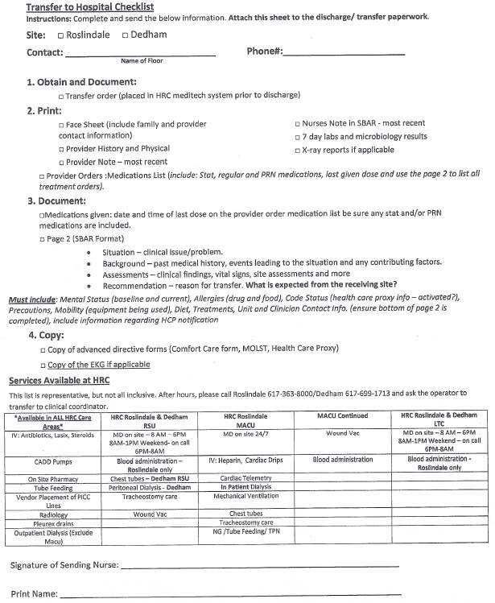
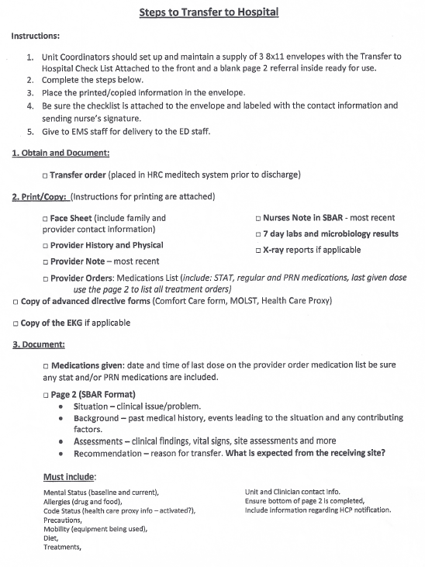
Interventions: One example
Improvement efforts started
Post-Intervention (performance) scores TBD
Partners Clinical Performance | Quality, Safety & Value Dept

Slide 7
Partners Discharges: Where the Pony Learned the Trick
The Problem
  Unsafe and inefficient care caused by late and incomplete clinical information sent to the next providers of care.
  Examples:
    Patient on anticoagulation arrived in SNF with these instructions: “Warfarin per INR”
    Transfer packet with two different “reconciled” medication lists
    Patient with mechanical heart value arrived without anticoagulation and no list of clinicians available to contact
    Patient arrived with recent stroke and altered mental status without description of mental status on transfer, returned to the ED for scan
  The first survey in 2003 showed 0 of 20 packets had all elements, 2/3 had 2/3’s of the elements, 1/3 had 1/3
  Completeness score (% discharge packets with all elements) = Zero
Partners Clinical Performance | Quality, Safety & Value Dept
Notes:
This 20 chart survey was all the data needed to convince PHS leadership that transitions were an issue of patient safety. This demonstrates the power of data and measurement. The first lesson.
We set up a focus group of post acute care MDs and NPs to identify the clinical information required for a safe transition. They members came up with 2500 elements which were whittled down to 325 with great effort.
Partners leadership, Jim Mongan in particular agreed that all PHS patients, should have all of these data elements that applied to them, for every transition.
However, his advice was to start with the one third of patients being discharged to post acute care, 1/3 instead of all patients. And, instead of 325 data elements, start with seven.
This was the second important lesson, scope it down
The Mongan seven has evolved and continues to evolve. The following slide show our current dashboard. This is what we report to all PHS boards. We continuously measure, analyze and report these data. The third lesson, make the data widely available. You can find these reports on the PHS website

Slide 8

Results: Seven Hospitals, Post-Interventions, Oct / Nov 2012
Overall | Total (Avg) | Site
 |  | A | B | C | D | E | F | G
Overall Completeness Score (% of “Complete” Discharge Packets) | 82.3% | 80.0% | 92.0% | 84.0% | 76.0% | 76.0% | 80.8% | 87.0%
Element
1. Reason for Inpatient Admission | 99.7% | 100.0% | 100.0% | 100.0% | 100.0% | 99.0% | 100.0% | 99.0%
2. Condition at Discharge | 96.1% | 98.0% | 98.0% | 98.0% | 92.0% | 99.0% | 94.9% | 93.0%
3. Principal Diagnosis at Discharge | 99.0% | 100.0% | 100.0% | 99.0% | 97.0% | 100.0% | 98.0% | 99.0%
4. Allergies | 98.1% | 100.0% | 99.0% | 97.0% | 98.0% | 96.0% | 99.0% | 98.0%
5. Discharge Medication Instructions | 96.3% | 89.9% | 100.0% | 98.0% | 94.2% | 96.0% | 99.0% | 97.0%
6. Major Procedures and Tests Performed | 97.6% | 100.0% | 98.0% | 100.0% | 96.0% | 99.0% | 97.0% | 93.0%
7. Pending Studies at Discharge | 93.4% | 94.0% | 99.0% | 93.0% | 100.0% | 87.0% | 86.9% | 94.0%
8. Contact Information for Studies Pending | 92.6% | 85.7% | 100.0% | 100.0% | 80.0% | 82.6% | 100.0% | 100.0%
9. 24/7 Contact Information | 99.7% | 100.0% | 100.0% | 100.0% | 100.0% | 99.0% | 100.0% | 99.0%
10. Follow-up Care Plan | 97.7% | 98.0% | 98.0% | 97.0% | 92.0% | 100.0% | 99.0% | 100.0%
11. Advanced Care Plan | 97.5% | 100.0% | 100.0% | 100.0% | 100.0% | 82.6% | 100.0% | 100.0%
12. Warfarin Overall | 86.2% | 87.5% | 100.0% | 90.0% | 60.0% | 100.0% | 73.9% | 92.3%
12a. Warfarin: Indication | 97.1% | 100.0% | 100.0% | 100.0% | 80.0% | 100.0% | 100.0% | 100.0%
12b. Warfarin: Target INR | 94.6% | 100.0% | 100.0% | 95.0% | 80.0% | 100.0% | 87.0% | 100.0%
12c. Warfarin: Anticipated Duration | 90.6% | 100.0% | 100.0% | 100.0% | 60.0% | 100.0% | 73.9% | 100.0%
12d. Warfarin: Sufficient Info (72 Hrs) | 95.8% | 87.5% | 100.0% | 95.0% | 100.0% | 100.0% | 95.7% | 92.3%
Overall Score= # cases for which discharge documentation included all 12 elements/ total # cases reviewed
Element Score= # cases for which discharge documentation included element/ total # cases reviewed
n= 699 across seven sites (A→G)
Overall Score: Color Thresholds
75% ≤ x ≤ 100% | 50% ≤ x < 75% | x < 50%
Element Color Scoring
97% ≤ x ≤ 100% | 90% ≤ x < 97% | x < 90%
Partners Clinical Performance | Quality, Safety & Value Dept
Notes:
Green represents 97% or above an individual measure, yellow above 90%, red below 90%. We measure 50 packets per hospital per quarter. We provide this summary to all PHS and hospital Boards where the CMOs get to explain any performance that’s not green.
Transparency becomes a very powerful inducement to improve.
We have applied this methodology for nine years.

Slide 9
Results: Over Time
Definition of Complete Discharge Content & Hospitals Included in the Measure Changed in Q4 CY 2009 and Q1 CY 2012 (see green arrow )
Hospitals Included since Q4 CY 2005 are: Brigham and Women’s Faulkner Hospital, Brigham and Women’s Hospital, Massachusetts General Hospital, North Shore Medical Center, Newton Wellesley Hospital; Emerson Hospital and Hallmark Health System added Q4 CY 2009; Martha’s Vineyard Hospital and Nantucket Cottage Hospital added Q1 CY 2012 but not in graph
Partners Clinical Performance | Quality, Safety & Value Dept
Notes:
The red line is the completeness metric. Remember it started off the chart at zero in 2002 and increased steadily to q1 ’09 when it fell from 96% to 50% in q1 ’10. What happened?

Slide 10
Results: Pre- and Post-Intervention, 2012
A B C D E F G
A B C D E F G
Improvement Efforts Included (not limited to):
Implemented new electronic discharge module—4 sites
Created new and improved patient instructions form—4 sites
Changed rules and regulations around discharge documentation—3 sites
Educated staff on importance of measures (provided training, spoke in meetings, wrote in newsletters, communicated via email, etc.)—5 sites
Used pocket-sized Discharge Reference Guides—5 sites
Provided feedback to individual departments regarding baseline and progress—5 sites
Executed hard stops in electronic systems—2 sites
Partners Clinical Performance | Quality, Safety & Value Dept

Slide 11
Lessons Learned, Barriers and Advice
Lessons:
  Measure, measure, measure.
  Start small (not 2500 data elements for all patient transfers)
  Leadership from the top (the Mongan 7)
  Publicly share data
  Be in it for the long haul
Barriers
  The initial sell to Leadership
Do overs
  Would be more strategic than opportunistic
Advice
  Start wherever, but start. “N of One”
Partners Clinical Performance | Quality, Safety & Value Dept

Slide 12
Appendix
Partners Clinical Performance | Quality, Safety & Value Dept

Slide 13
The Partners Discharge Transitions Steering Committee
Discharge Transitions Steering Committee Members representing each site include:
Partners Patient Safety Team for Discharge Transitions includes:
Entity | First Name | Last Name | Email | Title
BWH | Rob | Boxer | rboxer@partners.org | Attending Physician
BWH | Ann | Celi | aceli@partners.org | BWPO Physician
EH | Cathy | Price | cprice@emersonhosp.org | Hospitalist
BWFH | Katie Mae | Miller | kmmiller@partners.org | Director Case Management
BWFH | Debra | Torosian | dtorosian@partners.org | Director of Health Information Services (Medical Records)
BWFH/ BWH | Nina Alice | Chalfin | nchalfin@partners.org | BWPO Physician
HHS | Bill | Doherty | wdoherty@hallmarkhealth.org | Chief Medical Officer
HHS | Barb | Marullo | bmarullo@hallmarkhealth.org | Program Manager, Quality Improvement & Patient Safety
MGH | Shanda | Brown | sbrown29@partners.org | Manager, Project Support & Analytics
MGH | Gwen | Crevensten | gcrevensten@partners.org | Academic Hospitalist Service
MGH | Kathleen | Finn | kfinn@partners.org | Physician
MGH | Theresa | Mills | tmills1@partners.org | Senior Consultant, Center for Quality and Safety
MGH | Priya | Vader | pvader@partners.org | Senior Consultant, Performance Improvement
NSMC | Ginny | Dolan-Horgan | vdolanhorgan@partners.org | Director, Performance Improvement
NWH | Cheryl | Bardetti | cbardetti@partners.org | Interim Manager of Quality and Infection Control
NWH | Eleanor | Paglia | epaglia@partners.org | Hospitalist
NWH | Bert | Thurlo-Walsh | bthurlo@partners.org | Director of Health Care Quality
Entity | First Name | Last Name | Email | Title
PHS | Tejal | Gandhi | tgandhi@partners.org | Partners Chief Quality and Safety Officer
PHS/ BWH | Jeff | Schnipper | jschnipper@partners.org | Hospitalist, Co-chair of Partners Discharge Transitions
PHS/ SNE | Terry | O'Malley | tomalley@partners.org | Medical Director for Non Acute Care Services, Co-chair of Partners Discharge Transitions
PHS | Alison | Holliday | aholliday@partners.org | Project Manager, Patient Safety
PHS | Jason | Miller | jmiller15@partners.org | Program Director, Patient Safety
PHS | Vicki | Nielsen | vnielsen@partners.org | Project Specialist, Patient Safety
BWH= Brigham and Women’s Hospital; EH= Emerson Hospital; BWFH= Brigham and Women’s Faulkner Hospital; HHS= Hallmark Health System; MGH= Massachusetts General Hospital; NSMC= North Shore Medical Center; NWH= Newton Wellesley Hospital; PHS= Partners HealthCare System; SNE= Spaulding North End
Partners Clinical Performance | Quality, Safety & Value Dept

Slide 14
What do these metrics mean?
1. Completeness of ED Transfer Documentation
A “complete” ED transfer packet (all transfer-related written information sent to the ED) has all of the following elements (if applicable):
History of Current Issue
Current Active Clinical Conditions
Questions that Sending site wants answered
Clinician at Sending site available to answer questions
Clinician(s) to call for each urgent problem
Family contact information
Current active medications
Allergies
“Completeness” score= # cases with “complete” discharge packet/ # cases reviewed
Mental Status at Transfer
Mental Status at Baseline, if different
Ability to consent to treatment
Code Status
Orders for Life Sustaining Treatment Form
Scheduled treatments that may be required during the ED stay
Patient may return to facility if...
Facility capabilities
High risk lines
Epidural catheters
Dialysis
Aspiration risk
Severe depression
Internal defibrilator (AICD)
Drains
Ports
Total Parenteral Nutrition (TPN) Line
Medications: Date and time last dose administered
Peripherally inserted central catheter (PICC)
Total Parenteral Nutrition (TPN)
Limited/ non-weightbearing left/right, Upper/Lower
Foley
Fall risk (Yes or No) & Interventions
The next set of elements…
Clostridium difficile
Psychosis
Infection precautions
Methicillin-resistant Staphylococcus aureus
Chief Complaint
Vancomycin-resistant enterococci (VRE)
Extended Spectrum Beta Lactamase (ESBL)
Pregnant (Yes or No)
Significant Past Medical History
Vancomycin-Intermediate Staphylococcus aureus
Violent behavior
Devices
Pacemaker
Partners Clinical Performance | Quality, Safety & Value Dept

Slide 15
What do these metrics mean? (cont.)
2. Completeness of Discharge Documentation
A “complete” discharge packet (all discharge-related information sent with patient or to next health care provider) has all of the following elements (if applicable):
Reason for Inpatient Admission
Condition at Discharge
Principal Diagnosis at Discharge
Allergies
Discharge Medication Instructions
Major Procedures and Tests and Summary of Results
“Completeness” score= # cases with “complete” discharge packet/ # cases reviewed
Pending Studies at Discharge
Contact Info for Pending Studies at Discharge
24/7 Contact Information
Follow-up Care Plan
Advance Care Plan
Warfarin Information
3. Timeliness of Discharge Documentation
Transcription or typing of a “timely” discharge packet (all discharge-related information sent with patient or to next health care provider) is completed:
For patients discharged to a post-acute facility—by the same calendar day of discharge and no more than 2 days prior to discharge.
For patients discharged home—within 24 hours of discharge and no more than 2 days prior to discharge.
Timeliness score= # cases with “timely” discharge packet/ # cases reviewed
Exclusions
The following categories are excluded from the Patient Safety Discharge Transitions analysis: Transfers to other hospitals; Service to service transfers within a hospital; Discharges from Anesthesia, Emergency medicine, Newborn/ Special Care, Obstetrics and Radiology; Discharges to Observation; Patients who left against approval/ against medical advice or who are deceased.
Partners Clinical Performance | Quality, Safety & Value Dept

Slide 16

All sites improved Completeness of discharge documentation in ‘12; this was an enhanced metric to align further with MassHealth requirements
2012 Completeness of Discharge Documentation Improvements
(95% Confidence Interval)
Performance Score (Oct/Nov ‘12)
Baseline Score (Jan/ Feb ‘12)
% Cases with “Complete” Discharge Documentation
Site
(den= Baseline, Performance)
A B C D E F G Partners-wide
(n=100, 100) (n=100, 100) (n=100, 100) (n=100, 100) (n=100, 100) (n=100, 99) (n=100, 100) (n=700, 699)
Significant Progress Across Partners (63.29%→82.26%)
All Sites Improved between Baseline and Performance Period
4/7 Sites (A, C, D, G) Improved Significantly (p<.05)
Partners Clinical Performance | Quality, Safety & Value Dept

Slide 17
In Oct/Nov ‘12, 92.27% of d/c documentation was available to receivers within 24 hrs (for d/c to home) and on same calendar day (for d/c to facility)
2012 Timeliness of Discharge Documentation Improvements
(95% Confidence Interval)
Performance Score (Oct/Nov ‘12)
Baseline Score (Jan/ Feb ‘12)
% Cases with “Timely” Discharge Documentation
Site
(den= Baseline, Performance)
A B C D E F G Partners-wide
(n=100, 100) (n=100, 100) (n=100, 100) (n=100, 100) (n=6864, 8530) (n=100, 99) (n=100, 100) (differed by site*)
Significant Progress Across Partners (83.50%→92.27%)
All Sites Improved or Stayed the Same between Baseline and Performance Period
2/7 Sites (E, G) Improved Significantly (p<.05) and one (C) was very close
*Partners scores averaged based on percentage; not weighted.
Partners Clinical Performance | Quality, Safety & Value Dept

